Slide 1
GRAPH ALGORITHMS IN BIOINFORMATICS
Students Name:
Neha N
Shubhaprada K P
Sravan Karthick T
Ujwal P

Slide 2
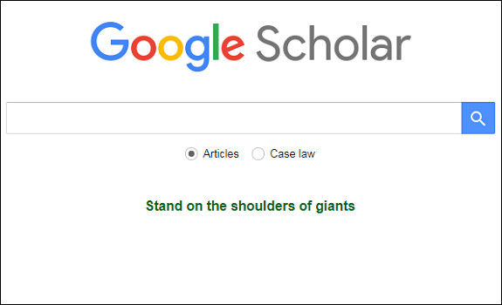
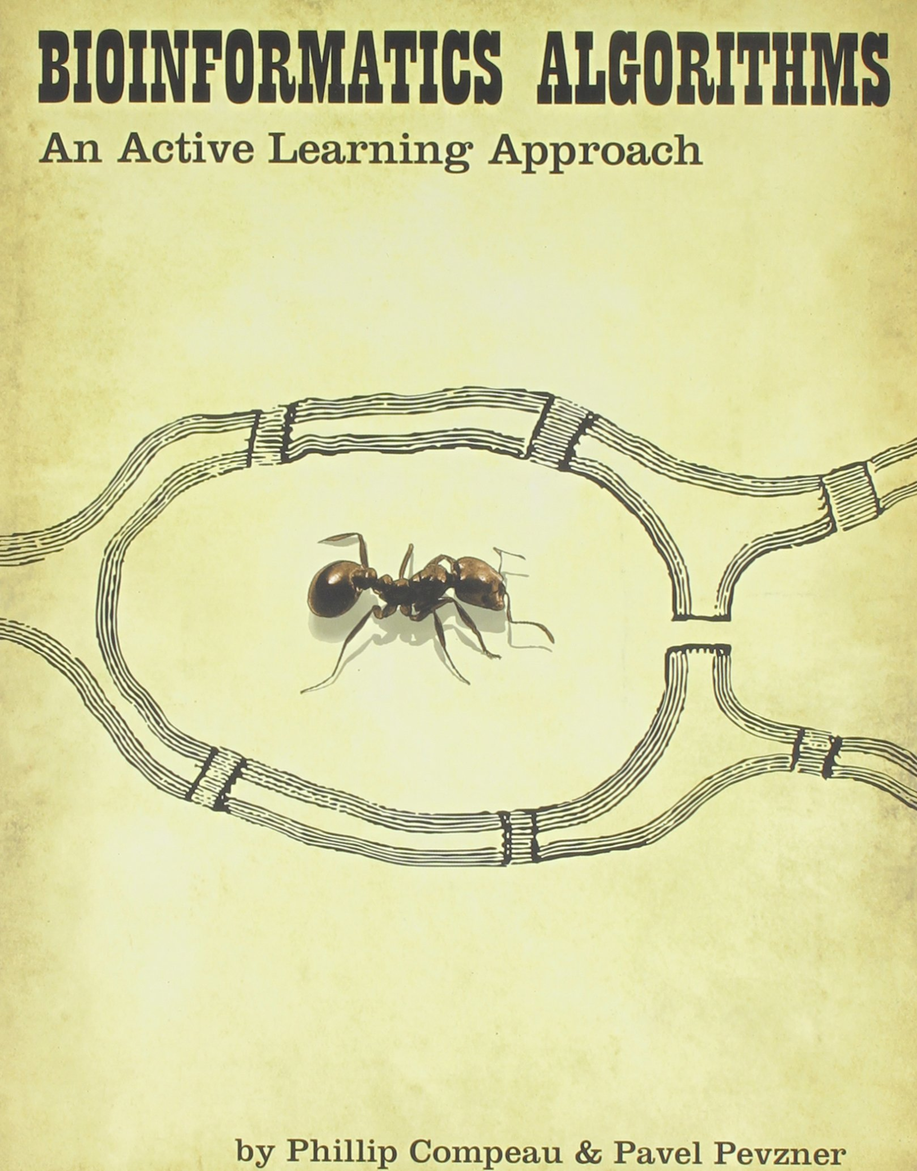
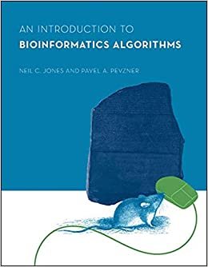



LITERATURE SURVEY
ks

Slide 3
LITERATURE SURVEY
TITLE | BIOINFORMATICS ALGORITHMS: AN ACTIVE LEARNING APPROACH, Chapter 3
AUTHOR | Phillip Compeau, Pavel A. Pevzner
SUMMARY | PUBLICATION DETAILS
Chapter 3 of this book is titled ‘How do we assemble genomes?’ The book outlines the procedure of assembling genomes using deBruijn graphs and Eulerian path It draws parallelism to other problems such as the Koniksberg bridges problem, and the exploding newspaper problem It also talks about the real problems while using these algorithms and how they can be solved | TITLE: Bioinformatics Algorithms: An Active Learning Approach, Volume AUTHORS: Phillip Compeau, Pavel Pevzner EDITION: 2, illustrated PUBLISHER: Active Learning Publishers, 2014 ISBN: 0990374602, 9780990374602

Slide 4
LITERATURE SURVEY
TITLE | Genome Assembly : A Review
AUTHOR | Arun Kumar , Vishal Verma
SUMMARY | PUBLICATION DETAILS
This paper explains that after getting reads from sequencing technologies, how complex and challenging is the task of reconstructing the original genome. It discusses De Bruijn and OLC graph based solutions for assembling genome. It discusses major challenges in genome assembly using these techniques. It also discusses major error handling techniques. | Published in: 2021 7th International Conference on Advanced Computing and Communication Systems (ICACCS) Conference Location: Coimbatore, India Date of Conference: 19-20 March 2021 Date Added to IEEE Xplore: 03 June 2021 Publisher: IEEE Electronic ISSN: 2575-7288 Print on Demand(PoD) ISSN: 2469-5556

Slide 5
LITERATURE SURVEY
TITLE | Enabling graph appliance for genome assembly
AUTHOR | R. Singh, J. A. Graves, S. Lee, S. R. Sukumar and M. Shankar
SUMMARY | PUBLICATION DETAILS
This paper discusses the feasibility and scalability issues of de Bruijn graph assembly. A de Bruijn graph represents a collection of read sequences by billions of vertices and edges, which require large amounts of memory and computational power to store and process. This is a major drawback. It discusses how shared memory systems can be leveraged to overcome some of these issues | Published in: 2015 IEEE International Conference on Big Data (Big Data) Conference Location: Santa Clara, CA, USA Date of Conference: 29 Oct.-1 Nov. 2015 Date Added to IEEE Xplore: 28 December 2015 Publisher: IEEE Link:https://ieeexplore.ieee.org/document/7364056

Slide 6
LITERATURE SURVEY
TITLE | De Bruijn Graph-Based Whole-Genomic Sequence Assembly Algorithms and Applications
AUTHOR | X. Kang, S. Tang, Y. Ma, R. Liu and Y. Wang
SUMMARY | PUBLICATION DETAILS
This paper discusses several latest sequence assemblers and their algorithms. It conducts a comparative study of some typical de Bruijn graph-based assemblers by stimulating the sequencing and assembly of Zebra fish genome data. | Published in: 2013 IEEE International Conference on Green Computing and Communications and IEEE Internet of Things and IEEE Cyber, Physical and Social Computing Conference Location: Beijing, China Date of Conference: 20-23 Aug. 2013 Date Added to IEEE Xplore: 12 December 2013 Publisher: IEEE Link: https://ieeexplore.ieee.org/document/6682403

Slide 7
LITERATURE SURVEY
TITLE | Toward a more holistic method of genome assembly assessment
AUTHOR | Adam Thrash , Federico Hoffmann & Andy Perkins
SUMMARY | PUBLICATION DETAILS
This paper discusses how to improve the efficiency of massive genome assembly process. This paper also reports on the current state of assembly assessment methods, compares them, and provides a comprehensive method that encompasses several aspects of quality assessment. The advantages and disadvantages of various methods are given and described, with recommendations based on analytical speed and user friendliness. | AUTHORS:Thrash, A., Hoffmann, F. & Perkins, A. TITLE:Toward a more holistic method of genome assembly assessment. Published in :BMC Bioinformatics 21, 249 (2020). Published : 06 July 2020

Slide 8
LITERATURE SURVEY
TITLE | AN INTRODUCTION TO BIOINFORMATICS ALGORITHM, chapter 8
AUTHOR | Neil C. Jones, Pavel A. Pevzner
SUMMARY | PUBLICATION DETAILS
The book discusses graph and its application to solve various bioinformatics problems like DNA sequencing, protein sequencing etc It discusses Eulerian and Hamiltonian algorithms and how they can be used in genomic sequencing | TITLE: An introduction to bioinformatics algorithm AUTHORS: Neil C. Jones, Pavel A. Pevzner PUBLISHER: Ane Books Pvt. Ltd ISBN: 978-8180520785 PUBLICATION DATE: 1 January 2004

Slide 9
LITERATURE SURVEY
TITLE | Accelerating De Bruijn Graph-Based Genome Assembly for High-Throughput Short Read Data
AUTHOR | Kun Zhao; Weiguo Liu; Gerrit Voss; Wolfgang Mueller-Wittig
SUMMARY | PUBLICATION DETAILS
The generated reads by emerging next-generation sequencing technologies are significantly shorter compared to the traditional Sanger shotgun sequencing method. This poses challenges for de novo assembly algorithms in terms of both accuracy and efficiency. In this paper, a scalable parallel algorithm to accelerate the de Bruijn graph-based genome assembly for high-throughput short read data is presented | Published in: 2013 International Conference on Parallel and Distributed Systems Date of Conference: 15-18 Dec. 2013 Date Added to IEEE Xplore: 01 May 2014 Electronic ISBN:978-1-4799-2081-5 Print ISSN: 1521-9097 INSPEC Accession Number: 14267954 DOI: 10.1109/ICPADS.2013.68 Publisher: IEEE Conference Location: Seoul, Korea (South)

Slide 10
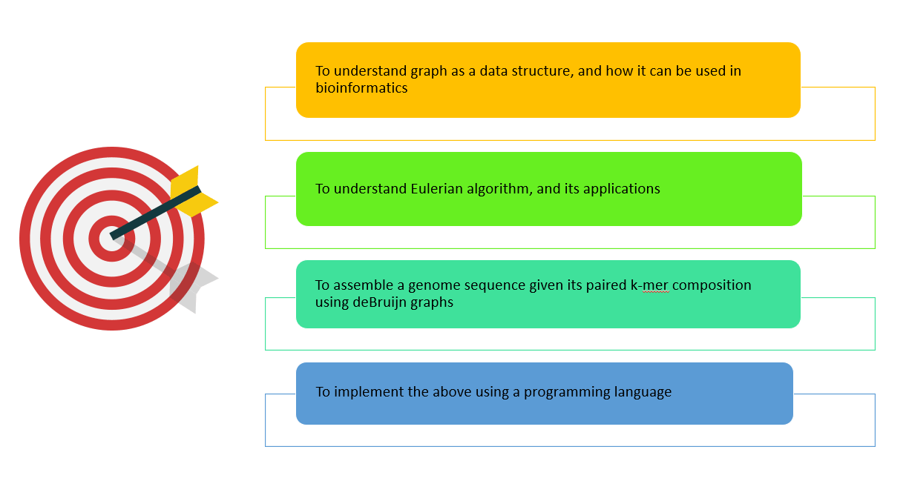
OBJECTIVES

Slide 11
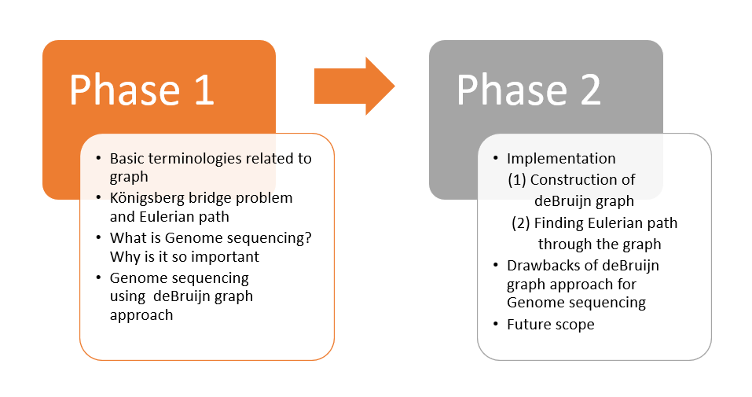
OUTLINE - HOW WE PLAN TO ACHIEVE THE OBJECTIVES

Slide 12
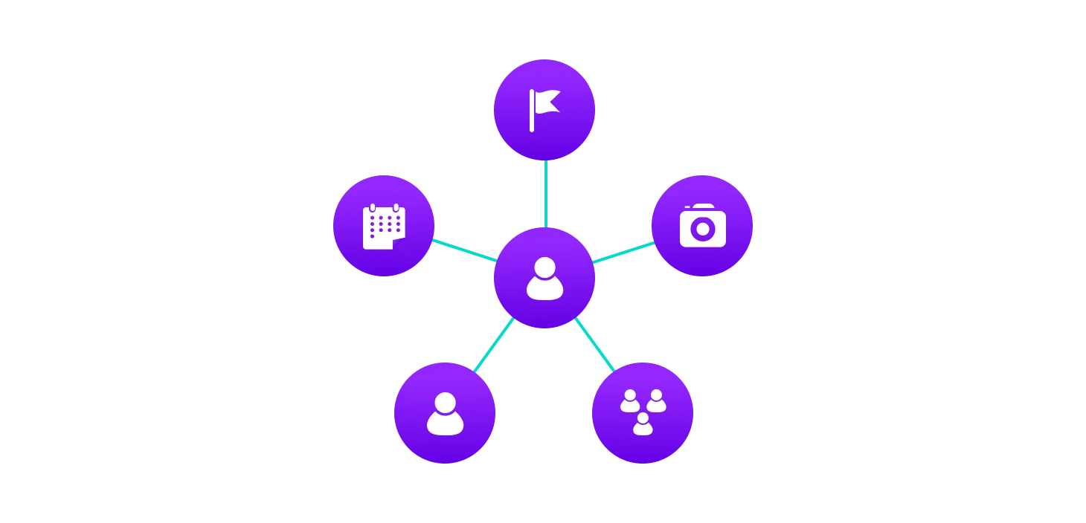
GRAPH - BASICS
Graphs represent connections between objects.
They describe many important phenomena.
Eg: Internet, Maps, Social Networks

Slide 13
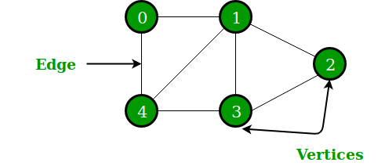
GRAPH - BASICS
Definition:
A Graph is a collection V of vertices and a collection E of edges, each of which connects a pair of vertices.

Slide 14
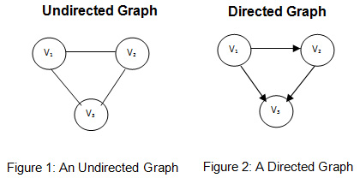
GRAPH - BASICS
Graphs are of two types:
Directed Graph
Undirected Graph

Slide 15
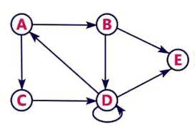
Graph - Basics
How are graphs represented?
Graphs are represented by:
List of edges
Adjacency Matrix
Adjacency List/Array
1) List of edges: {{A,C},{A,B},
{B,D},{B,E},{C,D},{D,E}}

Slide 16
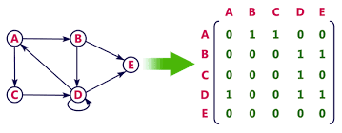
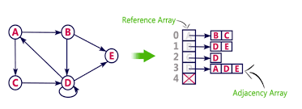
Graph - Basics
2)Adjacency Matrix
3)Adjacency List/Array

Slide 17

WHERE IT ALL STARTED-KONIKSBERG
uhhdffffffff
Our story begins in the 18th century, in the town of Königsberg, Prussia on the banks of the Pregel River.
The healthy economy allowed the people of the city to build seven bridges across the river
The people of the city decided to create a game for themselves, their goal being to devise a way in which they could walk around the city, crossing each of the seven bridges only once.
Leonard Euler was the one to solve this problem. Not only did he solve this, he devised a way to do it if any number of bridges were present

Slide 18
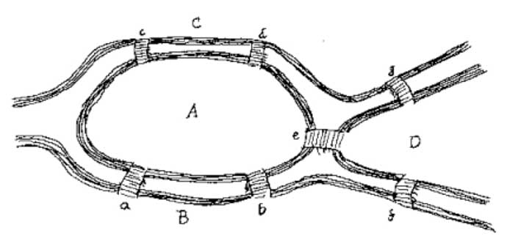
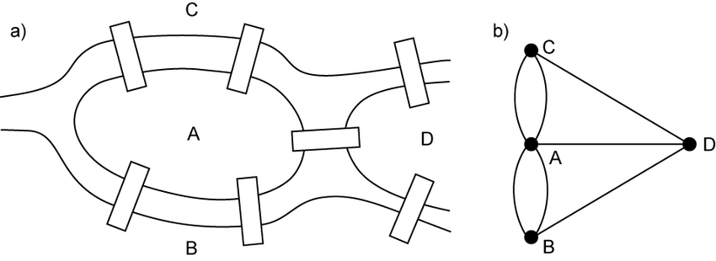
EULER’S SOLUTION
Euler accidentally sparked a new branch of mathematics called graph theory, where a graph is simply a collection of vertices and edges.
Today a path in a graph, which contains each edge of the graph once and only once, is called an Eulerian path, because of this problem.

Slide 19
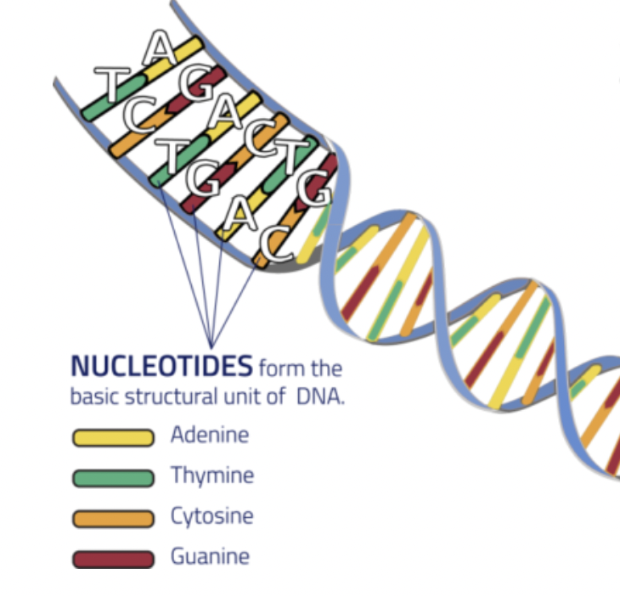
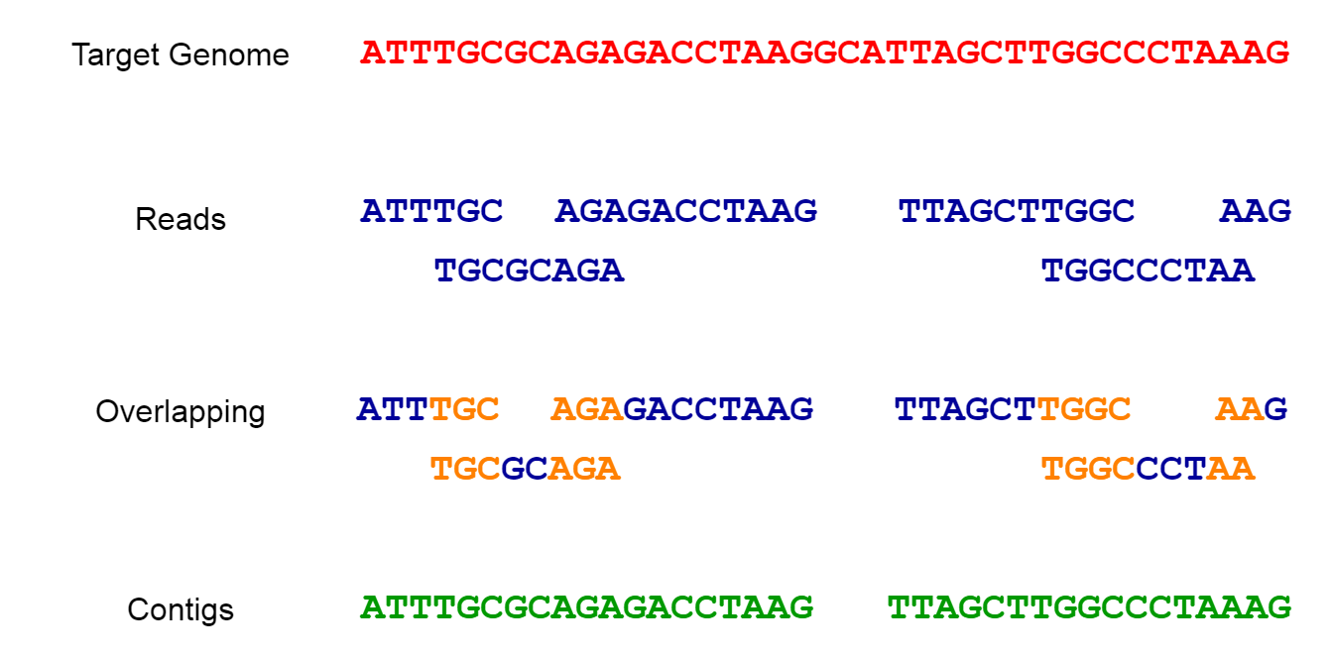
WHAT IS GENOME ASSEMBLY?
WHAT IS A GENOME?
A genome is all the DNA in an organism including its genes. DNA is made up of 4 chemicals(abbreviated as A,C,T,G) that are repeated millions of times in a genome. The order of these species is very important as it determines what type of species the organism is.
Sequencing technologies can read only a small amount of bases at a time and to read the whole genome, it takes a lot of attempts. As a result, we get subsets of DNA in millions.
The process of reconstructing the original sequences is known as genome assembly. Software used in this task are known as Genome Assemblers. Genome assembly is a complex and challenging task.
Notes:
DNA Sequencing Technology can read only parts of genome sequence at a time.
These subsets collectively build up the genome. These subsets may overlap or intersect with each other.

Slide 20
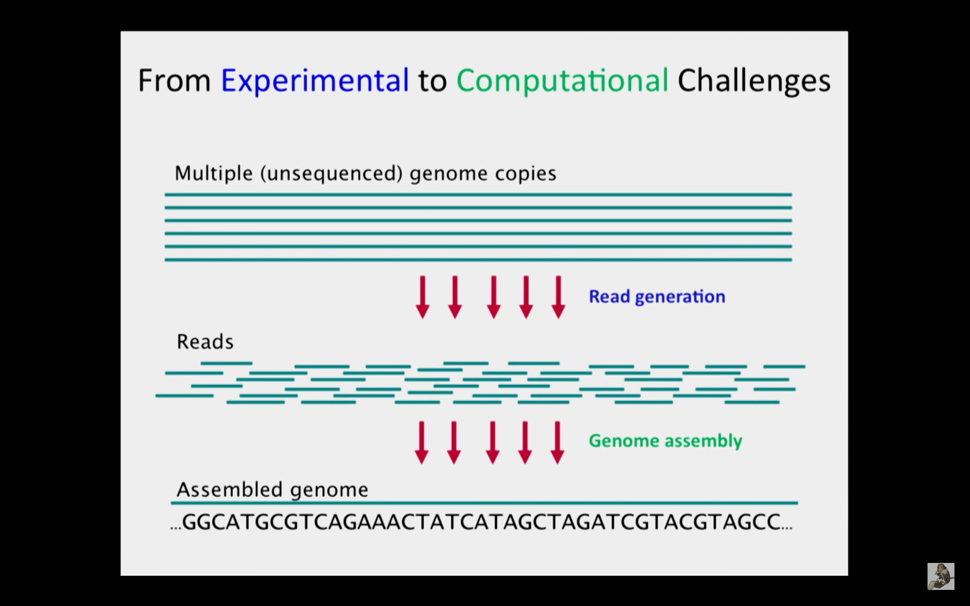
IMPORTANCE OF GENOME ASSEMBLY
Biologists are interested in genome sequencing because they can learn a lot by studying a genome.
They can understand the function of a human gene by studying a similar gene in a fly or even in bacteria.
There are numerous applications in medicine(genomes of fungi-producing bacteria), agriculture(oil palm genome), biotechnology(genomes of energy producing cyanobacteria), etc.

Slide 21
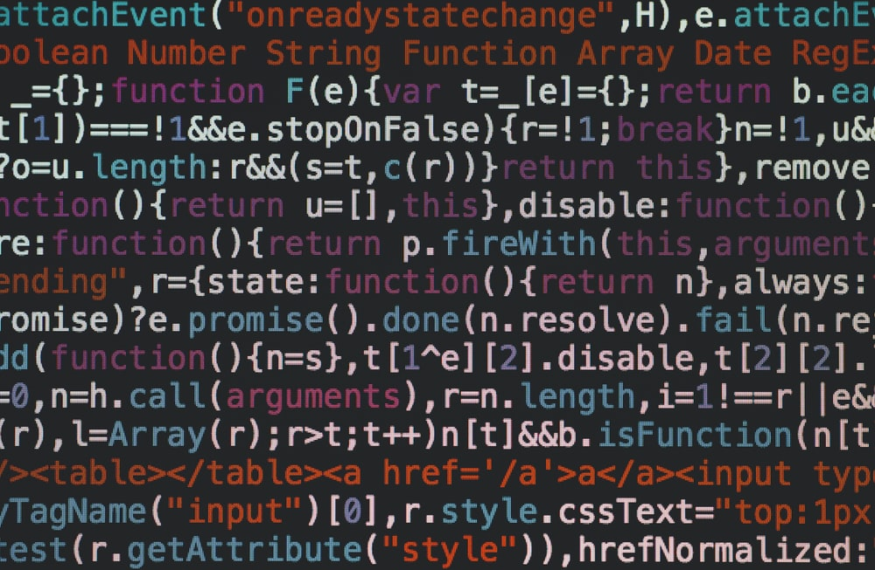


ALGORITHM AND CODE
Part 1: We will first discuss how to find Eulerian path given any directed graph. The code for this is written in c++
Part 2: Using the knowledge gained in part 1, we will construct a de Bruijn graph and traverse the de Bruijn graph following Eulerian path to assemble a genome. The code for this is written in python

Slide 22
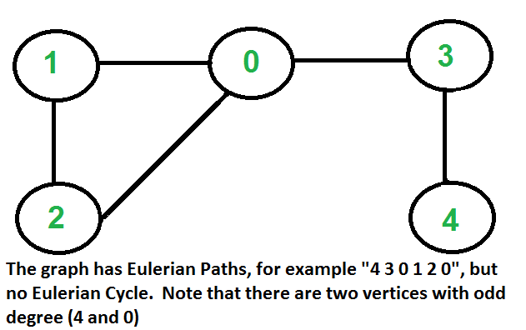
EULERIAN PATH- algorithm and code
HOW DO WE FIND THE EULERIAN PATH?
Euler path is a path that visits every edge exactly once.
Conditions:
every edge is visited once
start vertex != end vertex
exactly two vertices must have odd degree
all vertices with non-zero degree are connected

Slide 23
EULERIAN PATH- algorithm and code
ALGORITHM
Connectivity Check: do DFS and mark all nodes in component. Check if any node with degree > 0 is unvisited ⇒ if true ⇒ not euler graph
Count odd degree vertices:
count == 0 ⇒ eulerian graph
count == 2 ⇒ euler path is present
count > 2 ⇒ non-eulerian graph
code link: https://onlinegdb.com/VY37-hqqh

Slide 24
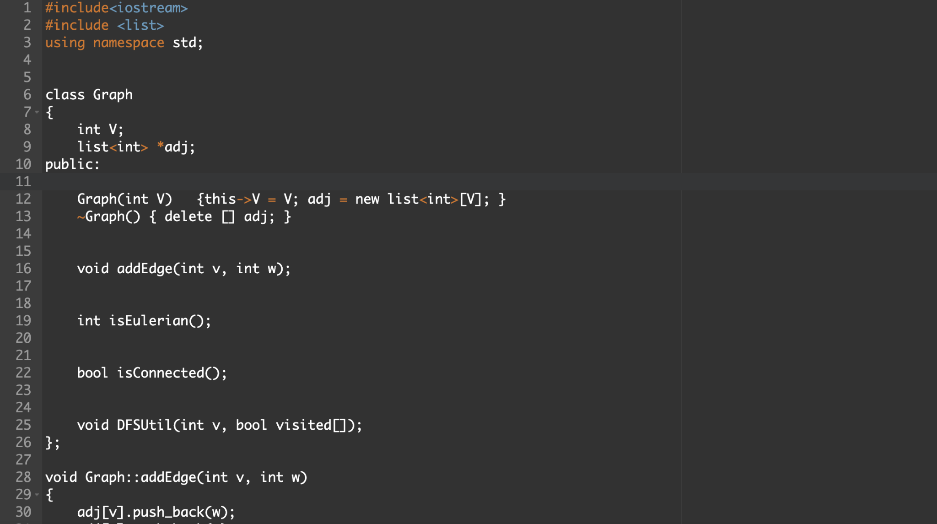
EULERIAN PATH- algorithm and code

Slide 25
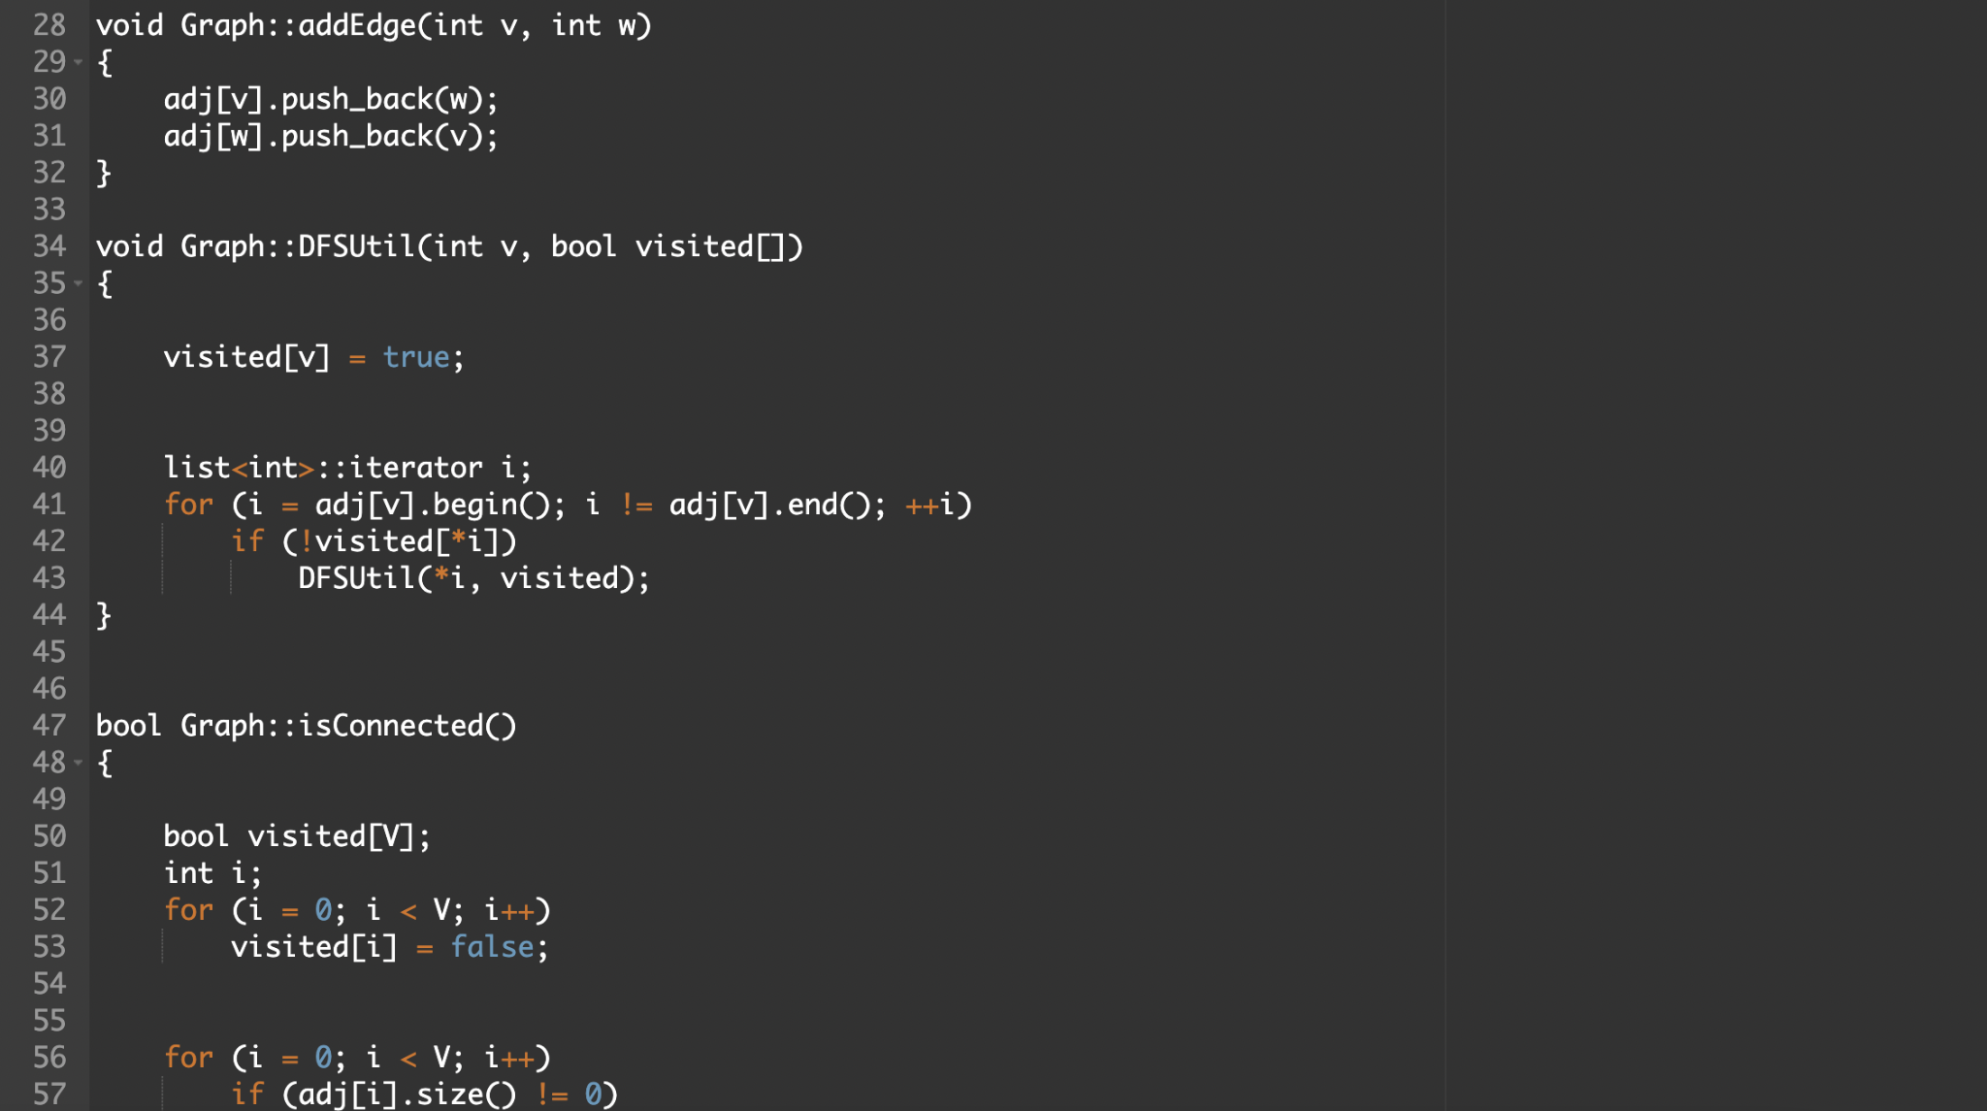
EULERIAN PATH- algorithm and code

Slide 26
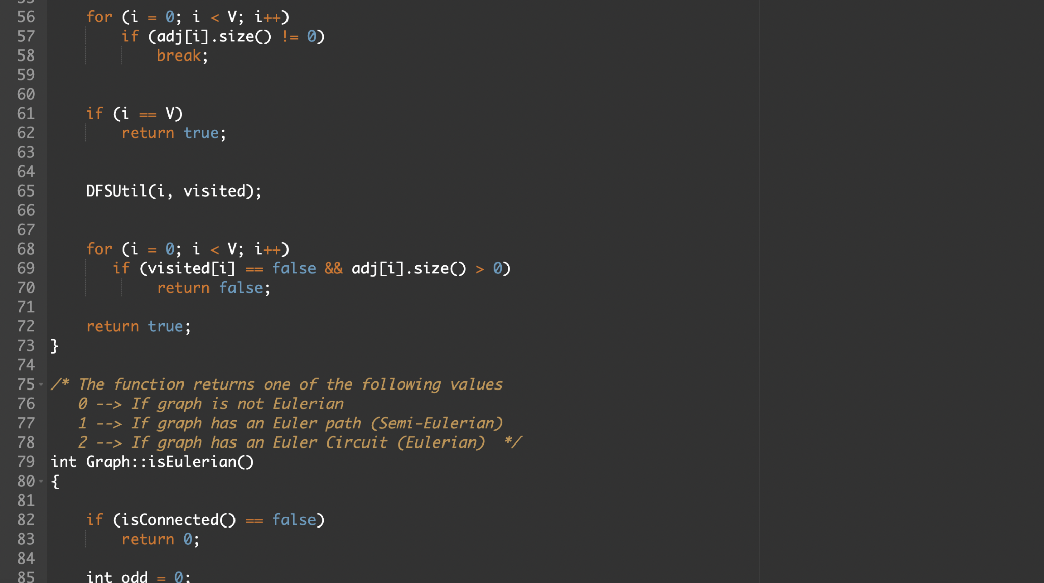
EULERIAN PATH- algorithm and code

Slide 27
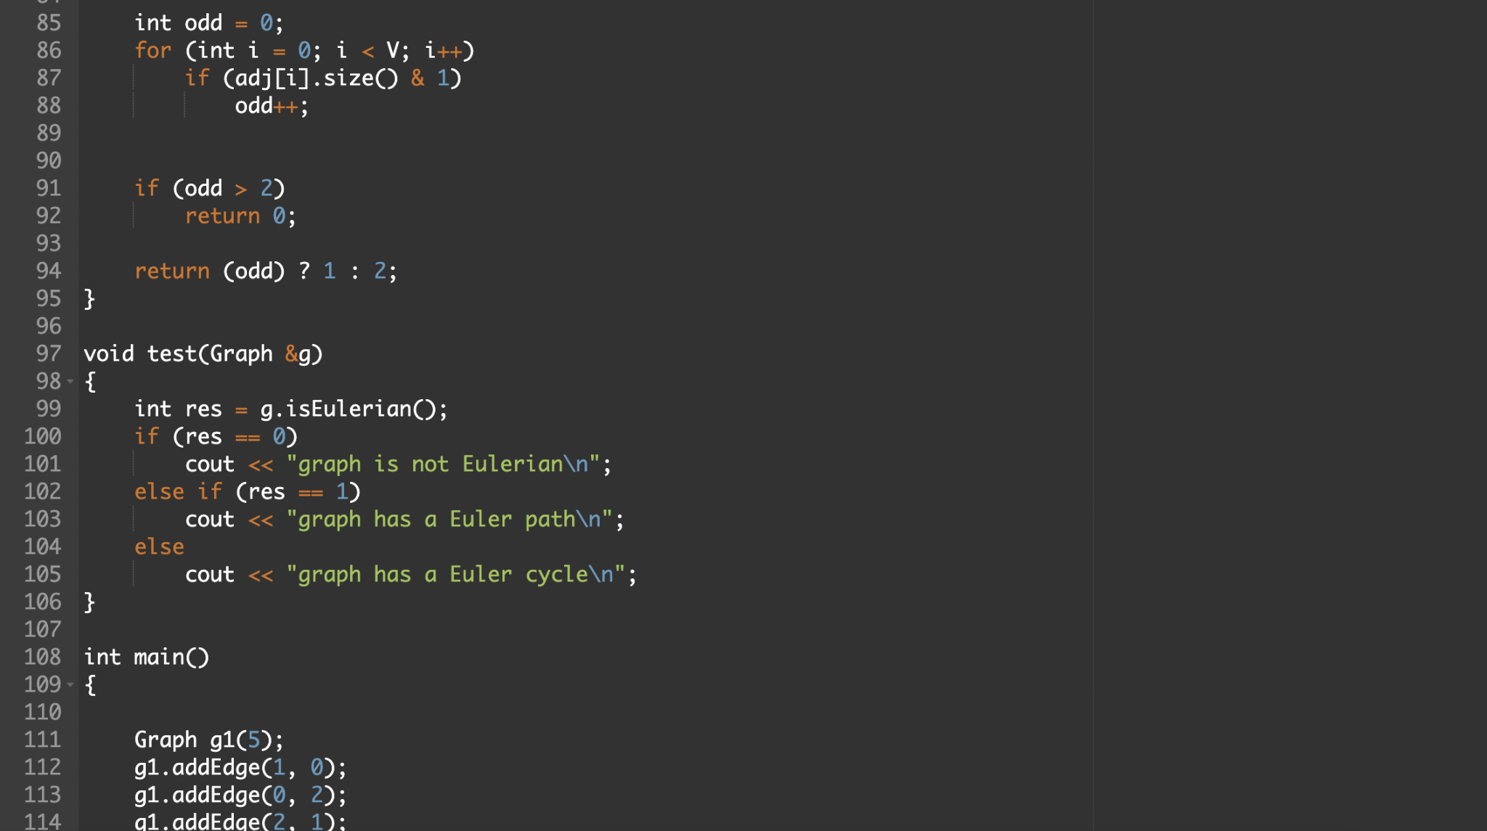
EULERIAN PATH- algorithm and code

Slide 28
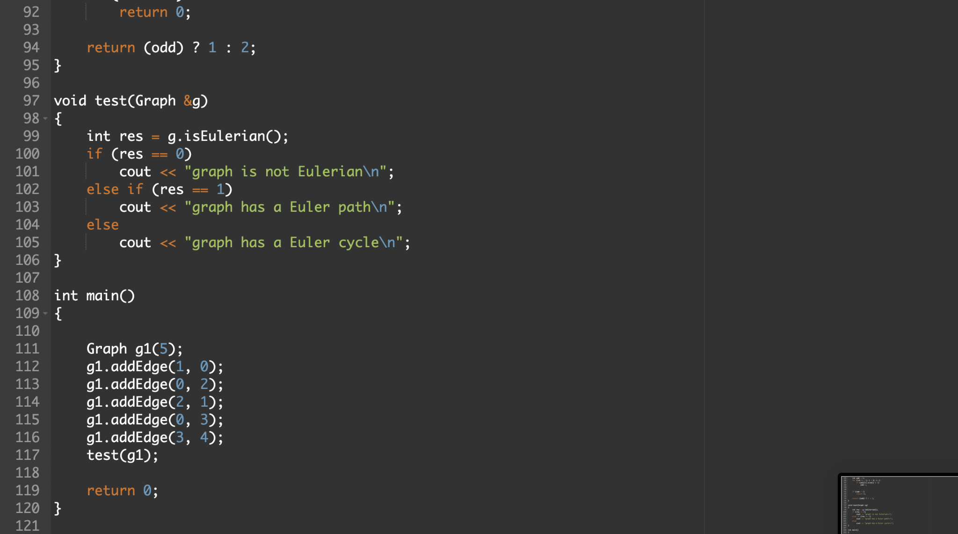
EULERIAN PATH- algorithm and code

Slide 29
DE BRUIJN GRAPH - algorithm + code
Problem statement: Given a number of short reads (substrings of the genome of particular length) assemble the genome sequence using de Bruijn graph.
Sample input: 'ATGC', 'TGCT', 'GCTG', 'CTGC', 'TGCT'
Sample output: ATGCTGCT
Step 1: Start with a collection of reads, which are substrings of the reference genome.
There are also called as k-mers where k is the length of each substring/read
ATGC
TGCT
GCTG here, k =4
CTGC
TGCT

Slide 30
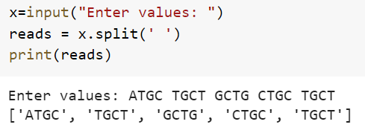
DE BRUIJN GRAPH - algorithm + code

Slide 31
DE BRUIJN GRAPH - algorithm + code
Step 2: Each k-mer input string is split into 2 overlapping substrings of length
k-1. Each of these are called the left (k-1)-mer and the right (k-1)mer.
ATGC
TGCT
GCTG
ATG
TGC
TGC
GCT
GCT
CTG
Each of 4-mer is split into respective right and left 3-mers.
(ATG,TGC) (TGC,GCT) (GCT,CTG) (CTG,TGC)
(TGC,GCT)
CTGC
TGCT
CTG
TGC
TGC
GCT

Slide 32
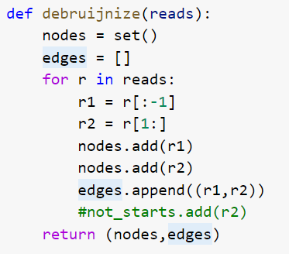
DE BRUIJN GRAPH - algorithm + code

Slide 33
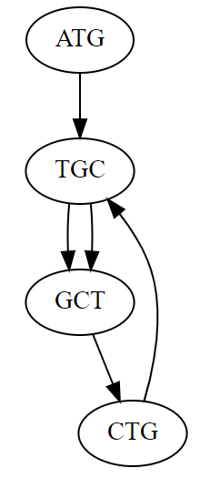
DE BRUIJN GRAPH - algorithm + code
Step 3: Each (k-1)-mer are acts as the nodes of the graph.(Add k-1 mers as nodes to
De Bruijn graph, if not already there). Draw a directed edge from each left
(k-1)-mer to corresponding right (k-1)-mer. Each edge in this graph is a k-mer
K-mers: 'ATGC', 'TGCT', 'GCTG', 'CTGC', 'TGCT'
(k-1)-mers: (ATG,TGC) (TGC,GCT) (GCT,CTG) (CTG,TGC)
(TGC,GCT)
Thus the De Bruijn graph is built.
ATGC
TGCT
CTGC
GCTG

Slide 34
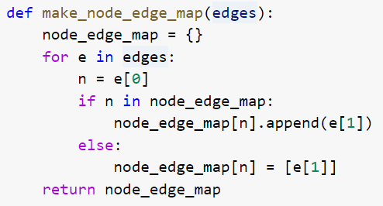
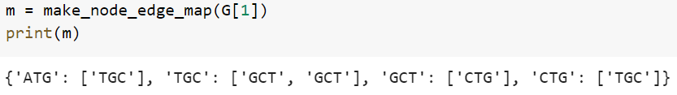
DE BRUIJN GRAPH - algorithm + code

Slide 35
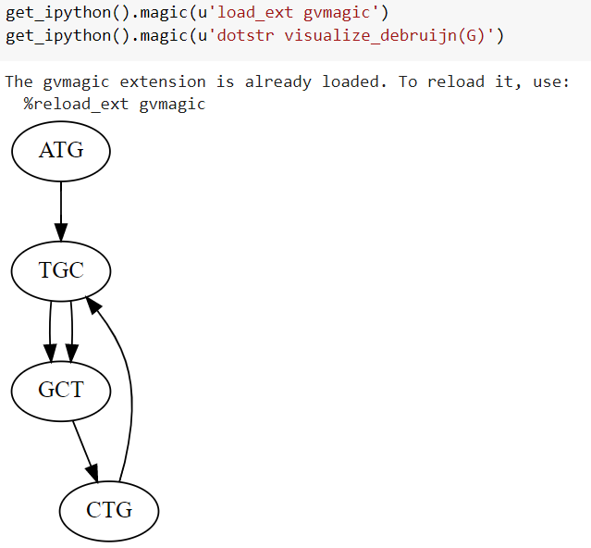
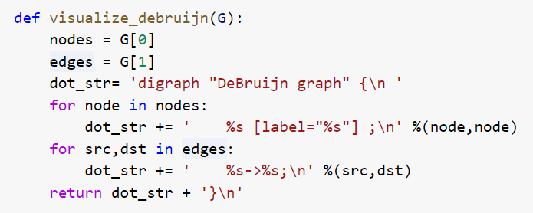
DE BRUIJN GRAPH - algorithm + code

Slide 36
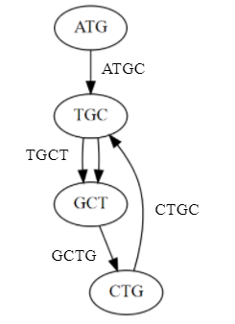
DE BRUIJN GRAPH - algorithm + code
Step 4: Traverse through this graph following the Eulerian path (Each edge is passed once). And the Genome is assembled.
Thus the Genome gets assembled.
We get ATGCTGCT which is the required output.
1
2
4
3

Slide 37
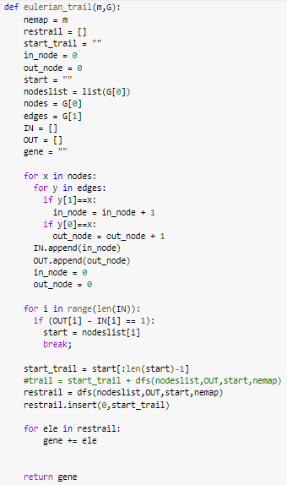
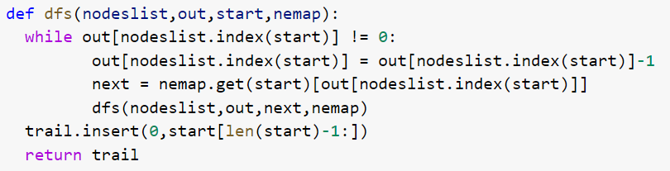
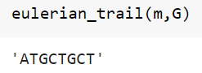
DE BRUIJN GRAPH - algorithm + code

Slide 38
DE BRUIJN GRAPH - Implementation
Code
https://colab.research.google.com/drive/1fWczjRSJA66oiyy3NehFSF5WMxS7_iGN#scrollTo=vRGr4UBrXEiQ

Slide 39
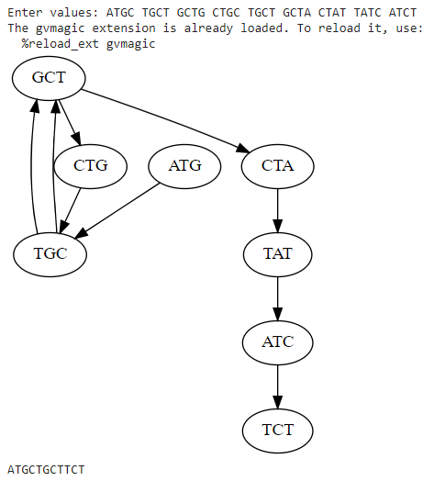
DE BRUIJN GRAPH - Implementation
Sample input and output 1

Slide 40
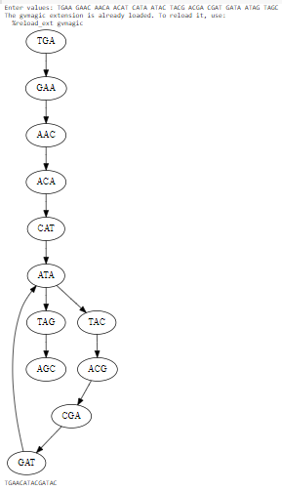
DE BRUIJN GRAPH - Implementation
Sample input and output 2

Slide 41
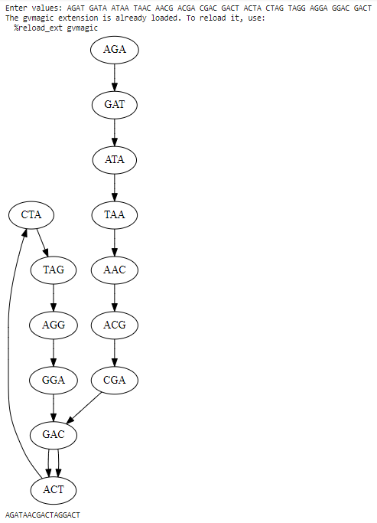
DE BRUIJN GRAPH - Implementation
Sample input and output 3

Slide 42
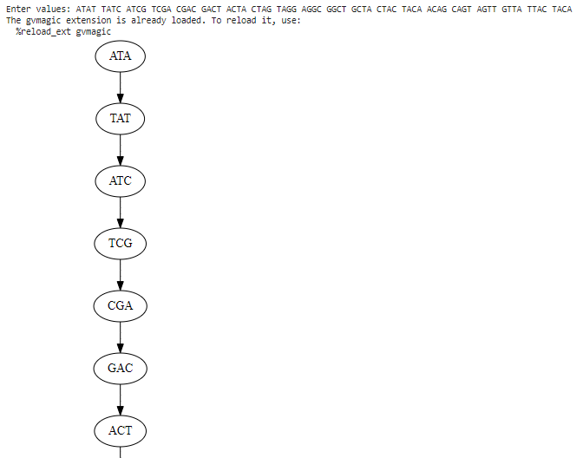
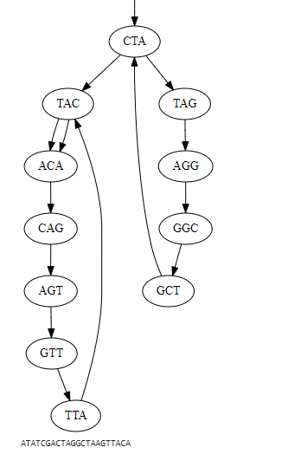
DE BRUIJN GRAPH - Implementation
Sample input and output 4

Slide 43
RESULTS & DISCUSSIONS
Graph theory is found to be a vital tool for solving biological problems.
De Bruijn Graphs and Euler’s algorithm are the backbone of almost every technique used while assembling a genome.
De Bruijn Graphs are found to be faster compared to other techniques and can also handle large inputs.
Drawbacks- As De Bruijn graph represents a collection of read sequences by millions of vertices and edges, it requires large amounts of memory and computational power to store and process. Reads are error-prone. Distance between reads within the read pairs are inexact.

Slide 44
RESULTS & DISCUSSIONS
Yet few things like high accuracy, less memory consumption and less time consumption in assembly are few required aspects which are primarily needed for assembling a genome. In case of large genomes like humans, it has become even more needed as the time and memory are consumed a lot.
In future genomes tens of thousands of species will be sequenced.
There are enormous efforts to sequence cancer genomes and understand what changes in the genome lead to cancer.
Thousands of cancer genomes have already been sequenced , and genome sequencing will soon become a routine technique in medicine.

Slide 45
REFERENCES
A. Kumar and V. Verma, "Genome Assembly: A Review," 2021 7th International Conference on Advanced Computing and Communication Systems (ICACCS), 2021, pp. 494-498, doi: 10.1109/ICACCS51430.2021.9441878.
R. Singh, J. A. Graves, S. Lee, S. R. Sukumar and M. Shankar, "Enabling graph appliance for genome assembly," 2015 IEEE International Conference on Big Data (Big Data), 2015, pp. 2583-2590, doi: 10.1109/BigData.2015.7364056.
X. Kang, S. Tang, Y. Ma, R. Liu and Y. Wang, "De Bruijn Graph-Based Whole-Genomic Sequence Assembly Algorithms and Applications," 2013 IEEE International Conference on Green Computing and Communications and IEEE Internet of Things and IEEE Cyber, Physical and Social Computing, 2013, pp. 2094-2097, doi: 10.1109/GreenCom-iThings-CPSCom.2013.393.
K. Zhao, W. Liu, G. Voss and W. Mueller-Wittig, "Accelerating De Bruijn Graph-Based Genome Assembly for High-Throughput Short Read Data," 2013 International Conference on Parallel and Distributed Systems, 2013, pp. 426-427, doi: 10.1109/ICPADS.2013.68.
https://www.geeksforgeeks.org/eulerian-path-and-circuit/
https://en.wikipedia.org/wiki/Eulerian_path
https://www.geeksforgeeks.org/hamiltonian-cycle-backtracking-6/
https://www.bioinformaticsalgorithms.org/bioinformatics-chapter-3
https://slaystudy.com/hierholzers-algorithm/
https://www.cs.jhu.edu/~langmea/resources/lecture_notes/assembly_dbg.pdf

